Slide 1
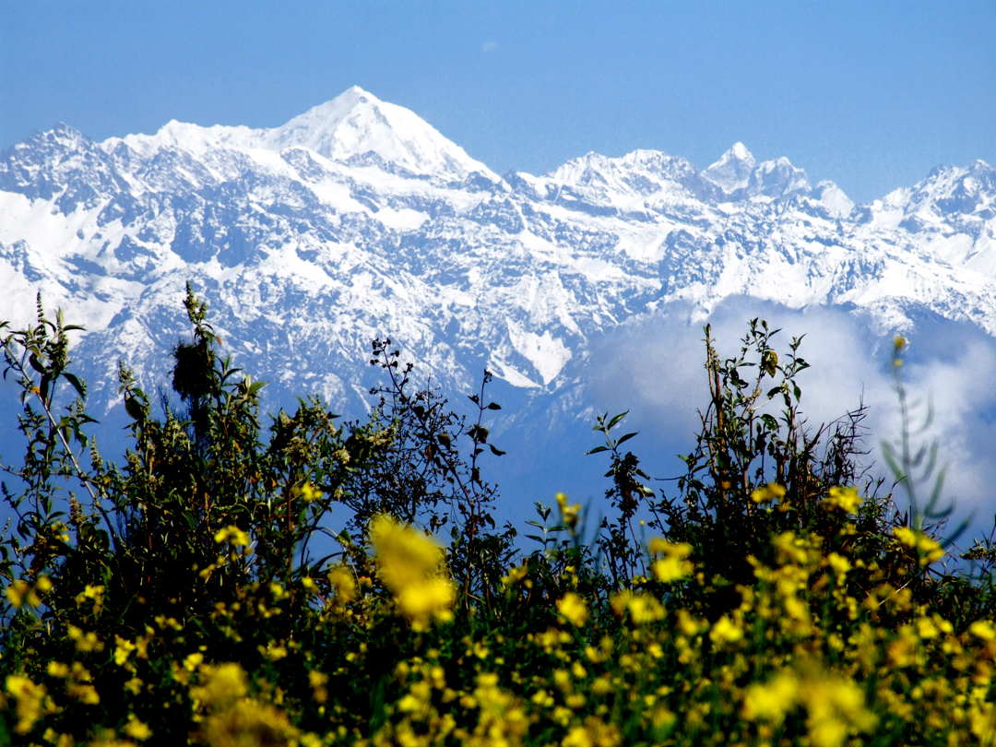
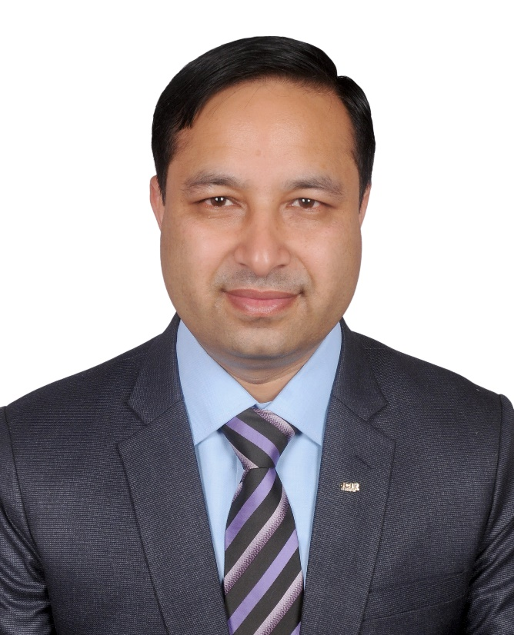
Welcome to PRE-INDUCTION & LOM OFFICER TRAINING
Updated on;
12 December 2021
JCI Sen. Bikash Manandhar National SG-2021 NJC

Slide 2



Pre-induction & LOM OFFICER TRAINING
JCI KAVRE NEPAL
JCI KAVRE LADY
JCI DHULIKHEL
JCI PANAUTI
JCI BHAKUNDEBESI
JCI NALDUM NAGARKOT
JCI BETHANCHOK
JCI PANCHKHAL (P)
JCI BANEPA JUNIOR
JCI DHULIKHEL JUNIOR
JCI PANAUTI JUNIOR
JCI BHAKUNDEBESI JUNIOR

Slide 3
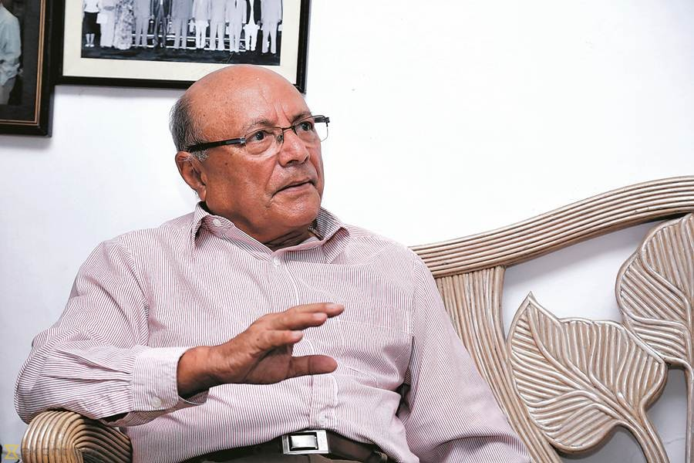

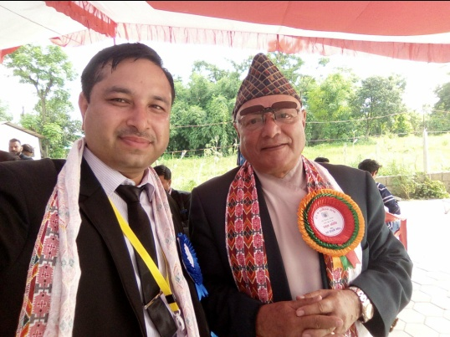
ABOUT JCI NEPAL
Sen. Dr. Bhek Bdr. Thapa
Estd. : 1964 A.D. , Sep. 17
Founder : Sen. Dr. Bhek Bdr. Thapa
Mother Chapter : JCI Gorakhpur (India)
LOM : 161
Member : 5000 +

Slide 4
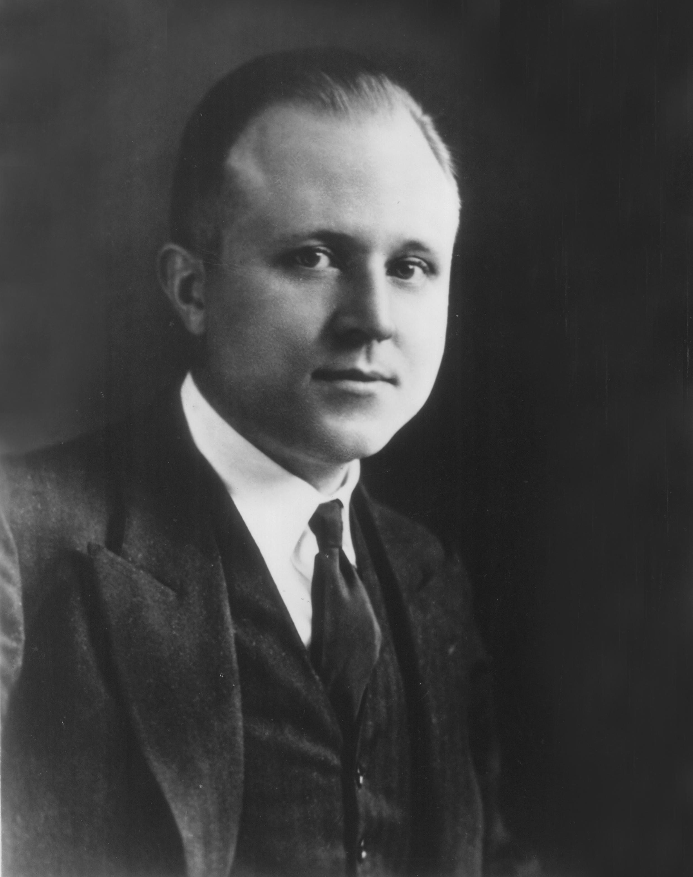
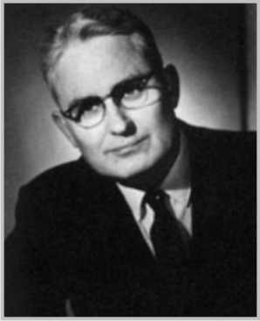
JCI Introduction (Junior Chamber International)
Henry Giessenbier
William Brownfield
Estd. Date : 1915 AD
Founder : Henry Giessenbier
JCI Creed : William Brownfield

Slide 5
JCI Introduction
200000 + Member
5000 + LOM (Local Organization Member)
120 + NOM (National Organization Member)

Slide 6
The JCI Mission.
"To provide development opportunities that empower
young people to create positive change. "
The JCI Vision
"To be the leading global network of young
active citizens."

Slide 7
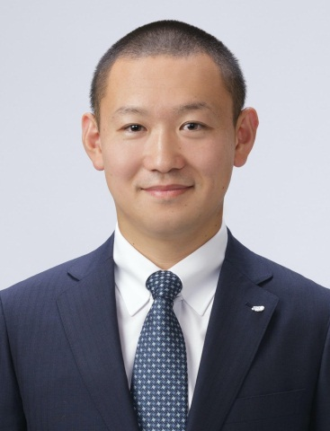
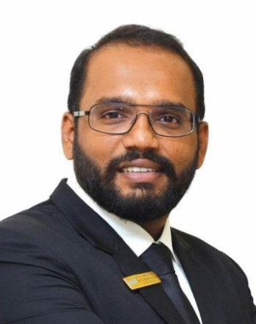
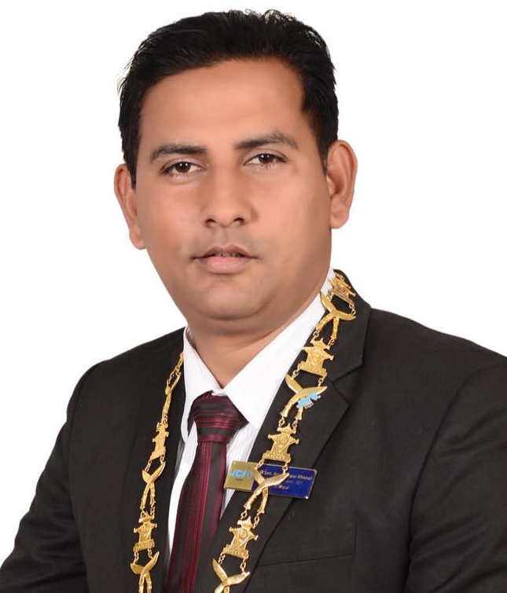
PRESIDENT: Assign VP YEAR 2021
Sen. Marc Brian Lim
President (JCI)
JCI Japan
Kaveen Kumar Kumaravel
Assign VP For Nepal
JCI India
Sen. Aruneshwor Khnal President (JCI Nepal)
JCI Bishazar

Slide 8
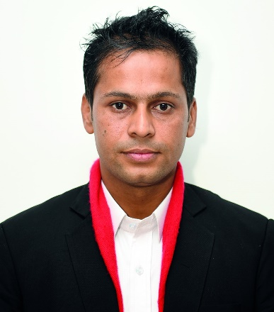
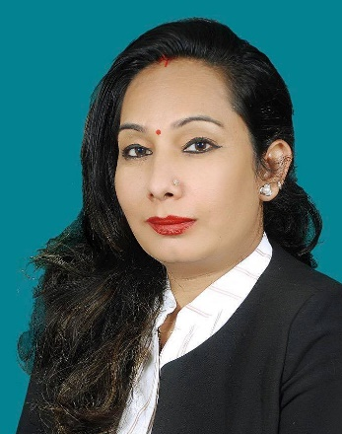
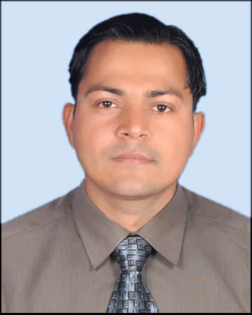
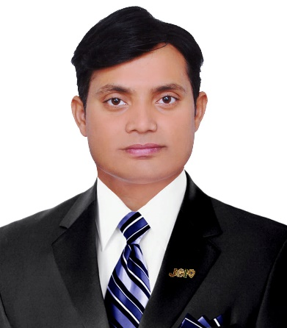
Assign Team For Area ‘C’
Jc Shiva Pd Bhusal
National EVP
JCI Sauraha
Jc Bimala Subedi
National VP
JCI Duhabi
Jc Rajan Gautam
National VP
JCI Rajahar
Jc Gautam Shah
National VP
JCI Janakpur

Slide 9
AREA WISE CHAPTERS
AREA 'A' : 41 Chapters
EVP : Sen. Arun Kumar Dahal (Hetauda)
VP : Jc Rajani Thapa (Manohara)
VP : Jc Anoj Joshi (Narayangarh)
VP : Jc Pramisha Kafle (Sharadhanagar)
AREA 'B' : 35 Chapters
EVP : Jc Bhojraj Chapagain (Ramnagar)
VP : Jc Bimal Jnawali (Sainamaina)
VP : Jc Dipendra Niraula (Dharan)
VP : Jc Sunil Timalsina (Tarahara)

Slide 10
AREA WISE CHAPTERS
AREA 'C' : 35 Chapters
EVP : Jc Shiva Pd. Bhushal (Sauraha)
VP : Jc Rajan Gautam (Rajahar)
VP : Jc Gautam Shah (Janakpur)
VP : Jc Bimala Subedi Karki (Duhabi)
AREA 'D' : 50 Chapters
EVP : Jc Suman Krishna Shrestha (Patan)
VP : Jc Sujan Baruwal (Myagdi)
VP : Jc Kalpan Pandey (Kushum) (Butwal Lady)
VP : Jc Payal Sharma (Lamgunj)

Slide 11
LOM OFFICERS
PRESIDENT
IMMEDIATE PAST PRESIDENT (IPP)
SECRETARY GENERAL (SG)
GENERAL LEGAL COUNCIL (GLC)
TREASURER
EXECUTIVE VICE PRESIDENT (EVP)
VICE PRESIDENT (VP)
TRAINING COORDINATOR (TC)
PUBLIC RELATION OFFICER (PRO)
THEME DIRECTOR (TD)
FUND RISING CHAIRMAN (FRC)
LOM EDITOR
MEMBER GROWTH CHAIRMAN (MGC)
INTERNATIONAL CO-ORDINATOR

Slide 12

JCI OPPORTUNITIES
INDIVIDUAL -JolQmut_
COMMUNITY -;fd'bflos_
BUSINESS -Aofkf/_
INTERNATIONAL -cGt/f{li6«o_

Slide 13
BOD OF JCI NEPAL
PRESIDENT 1 ELECTED
IPP 1
EVP 4 ELECTED
GLC 1 NOMINATED
SG 1 NOMINATED
TREASURER 1 NOMINATED
VP 12 ELECTED

Slide 14
BOD OF JCI
PRESIDENT 1 ELECTED
IPP 1
EVP 4 ELECTED
GLC 1 NOMINATED
SG 1 PAID
TREASURER 1 NOMINATED
VP 17 ELECTED

Slide 15
AREA OF JCI NEPAL
Area 'A' -hgsk'/ b]lv k"j{_
Area 'B' -la/u+h b]lv klZrd gf/fou9 b]lv kf]v/f, kj{t, afUn'ª_
Area 'C' -sf7df08f}, eQmk'/, sfe|], l;Gw'kfNrf]s, nlntk'/, kf6g, wflbª_
Area 'D' -gf/fo0fu9 k'n kf/L klZrd gjnk/f;L b]lv ;'b'/ klZrd dx]Gb|gu/ ;Dd_

Slide 16
NATIONAL PROGRAM (JCI NEPAL)
Rise to Change, Leadership Practices for Human Development
NOM / LOM Leaders Academy 1
Councilor Academy 1
President Meet (Area A, B, C, D) 4
Area Conference (Area A, B, C, D) 4
Lady Jaycees Academy 1
Business Academy 1
JCI Nepal Academy 1
Junior Leaders Academy 1
TOT 1
Master TOT 1
National Convention 1

Slide 17
NATIONAL HOST BY 2021
LOM/NOM Leaders Academy JCI Nepal (Feb.)
Councilor Academy JCI Nepal (March/April)
President Meet (Area A, B, C, D) (April/May)
Area A Area B
Area C Area D
Area Conference (Area A, B, C, D)
Area A JCI Inaruwa Area B JCI Palung
Area C JCI Ramechhap Area D JCI Birendranagar
Lady Academy -
JCI Nepal Academy -
Junior Leaders Academy -
TOT -
Master TOT -
48th National Convention JCI Pokhara (Area B)

Slide 18
JCI PROGRAM HOST BY 2021
Asia Pacific Conference JCI Tichune, Tiwan
JCI Academy Sendai,Japan
September 17 to 26, 2021
Singapore Academy JCI Singapore
Global Partner Summit JCI America
World Congress JCI Johannesburg, South Africa (November 16-20, 2021)

Slide 19
Duties of LOM Officer
President
Secretary General (SG)
Treasurer
General Legal Council (GLC)
Executive Vice President (EVP)
Vice President (VP)
Co-Ordinators

Slide 20
Management Information System (MIS)
www.jcinepal.org.np
How To Join
How To Manage Team (BOD)
How to Post and Edit News
How to Download LOM Logo/Form
How to get Information about NOM/LOM/Individual Member/Area Wise Member

Slide 21

The End
Thank You
ho h];Lh .

